Slide 1


Generation of Electric Energy from Wind in the United States
Data Analysis & Visualization
Team
Turbine
AI
Boot
Camp

Slide 2

Executive Summary & Approach
Problem to Solve
Demand for electric energy is increasing.
Fossil fuels are not a solution, given decarbonization is a clear global and national need due to climate change.
Generation of energy from wind is a compelling solution, given improvements in wind turbine technology.
But, is it a “better solution” than other renewable options or other low CO2 options (i.e., nuclear)?
To answer this question, we first need to understand the history of energy production in the US.
Goals
Characterize energy production by source.
Characterize wind energy production.
Characterize geographic distribution of wind energy.
Characterize geographical potential of wind energy.
Characterize the manufacturers of wind turbines.
Findings
Wind power is the 5th largest generator of electric energy in the US, and growing rapidly.
Variation in power generation over a year for wind, is less than for solar, a competing technology.
Total net wind energy generation does not - smoothly - follow wind turbine installation data.
Texas, by far, is the largest producer of electric energy from wind.
Conclusion
Further analysis of wind power generation, particularly against other low-CO2 sources, is very compelling.
Texas
Challenges:
GeoPandas & Other Libraries & API Calls
learning curves
large dataset required a lot of pre-manipulation before merge / analysis
GitHub
Forks / Branches / Merges
Working as a Team
during Holiday week
in compressed timeframe
with absentee member

Slide 3
Results & Conclusions
US Energy Production -> Wind Energy

Slide 4
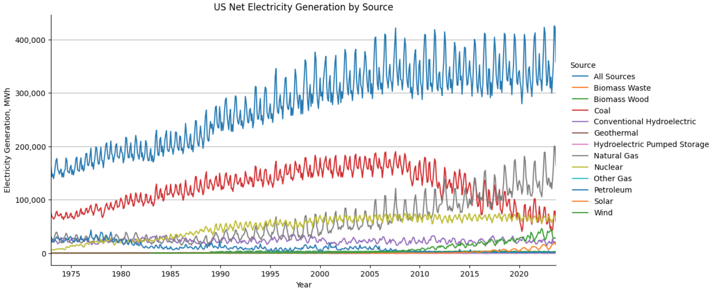
1
US Net Electricity Generation by Fuel Source
1
2
Observations from Data
1
Total energy production plateaus.
3b
3a
2
Coal begins decline.
4
3a
1st change in trend slope (drilling increase)
Natural Gas
3b
2nd change in trend slope (co-generation)
Total net electric energy production, long reliant on coal and other fossil fuels, has come to rely on a more diverse set of fuel sources.
4
Start of Solar (1984) and Wind (1985) energy production.

Slide 5
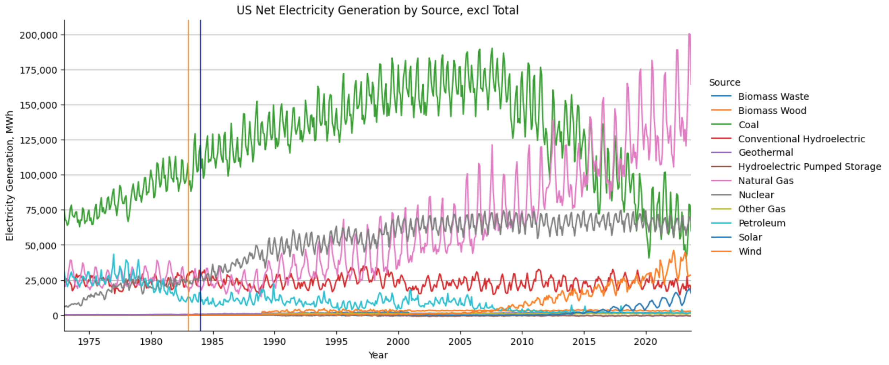
Results & Conclusions
1
[
Observations from Data
2
3
1
Coal begins decline.
4
2
1978 Public Utility Regulatory Policies Act (PURPA) encourages nat-gas co-generation.
3
Nuclear energy production plateaus.
5
Solar energy production overtakes conventional hydroelectric energy production, becoming 4th largest source.
4
5
Wind energy becomes 5th largest source of electricity generation.

Slide 6
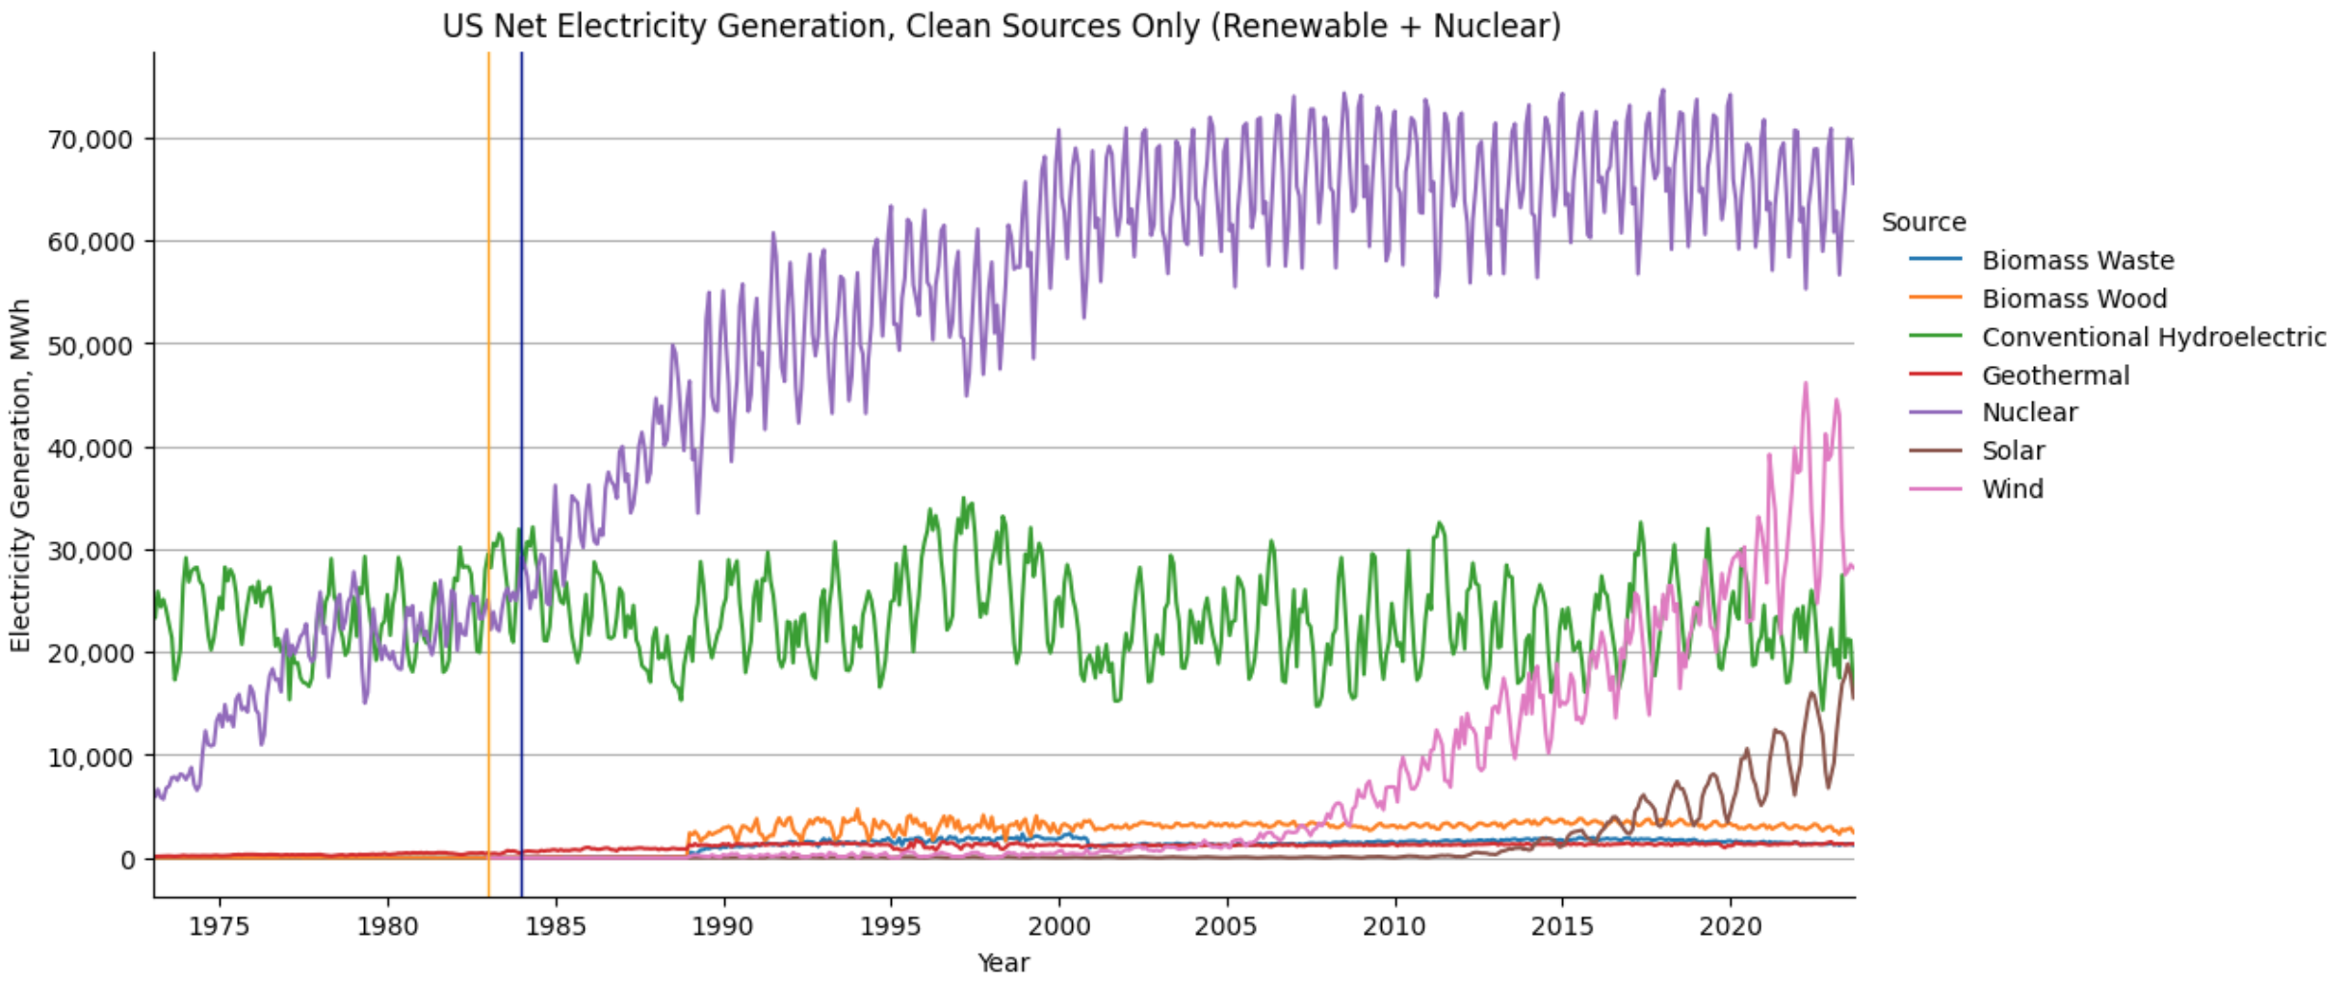
Low CO2 Sources
US Net Electricity Generation, Low CO2 Sources
Observations & Future Analysis
1
Solar electricity generation varies more than wind, in a given year. What drives variation?
2
Is US policy rewarding low cost / high potential sources?
3
Should the US expand nuclear energy production?

Slide 7
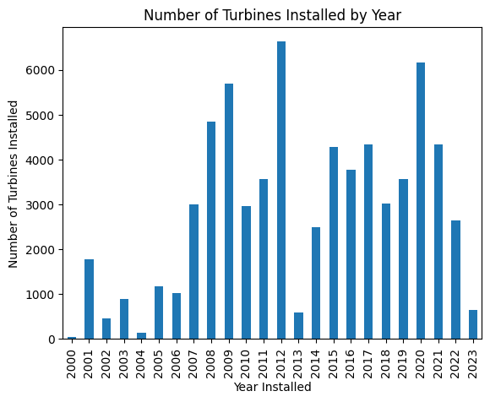
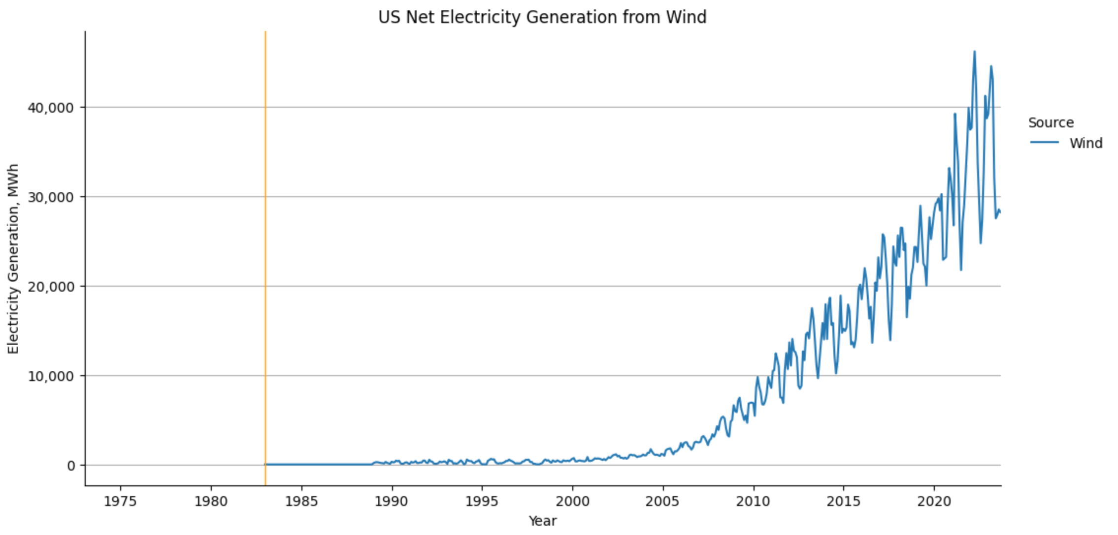
Wind Energy and Turbine Installations
3
2
[
[
1
Wind turbine installations vary widely.
Troughs seem to occur ~3-4 years after difficult economic periods, suggesting an equivalent lag between commitment of installation funds and installation.
Wind Energy Production curve exhibiting strong growth after ~2007, following change in trend slope at points 1, 2 and 3.

Slide 8
Wind Energy Generation Geographic Distribution

Slide 9
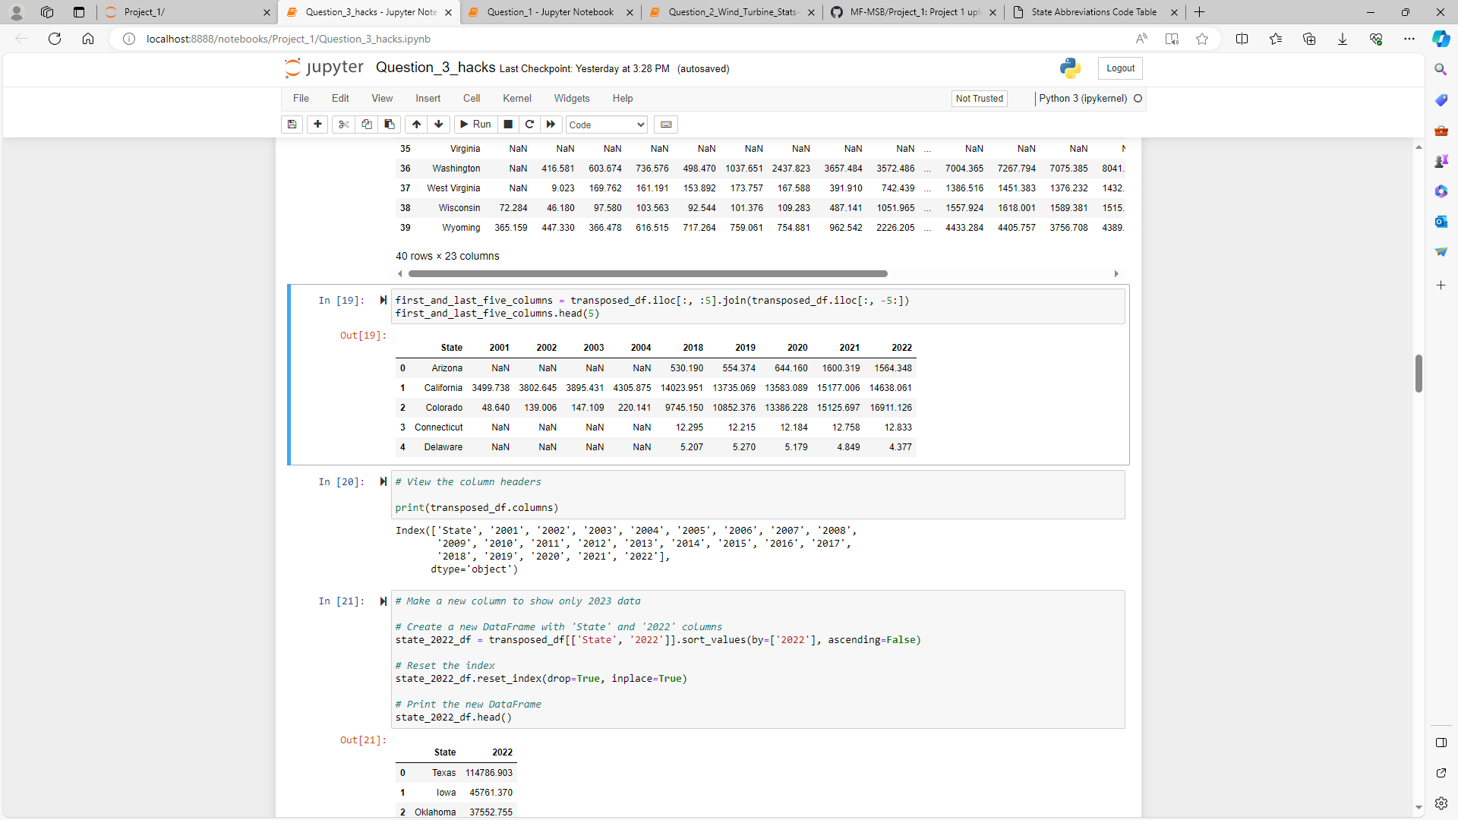
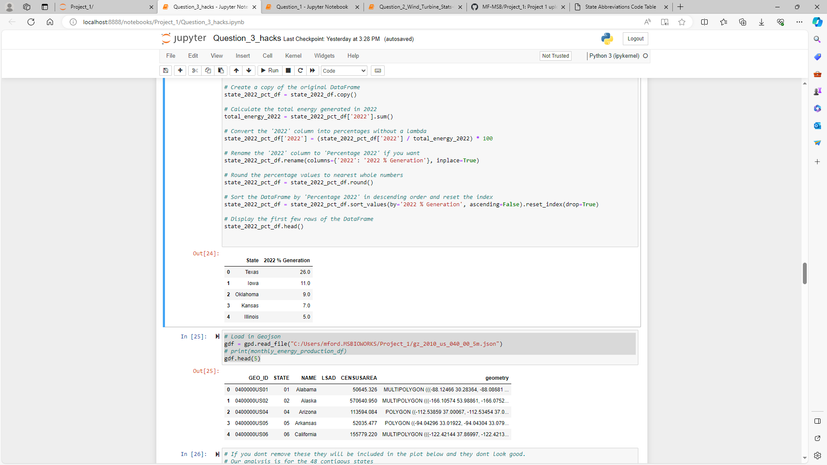
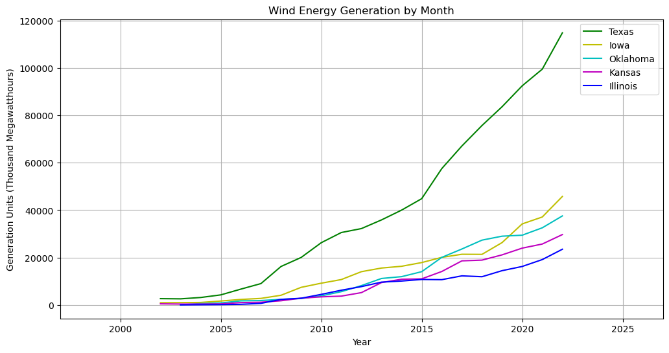
Wind Energy Generation by State

Slide 10
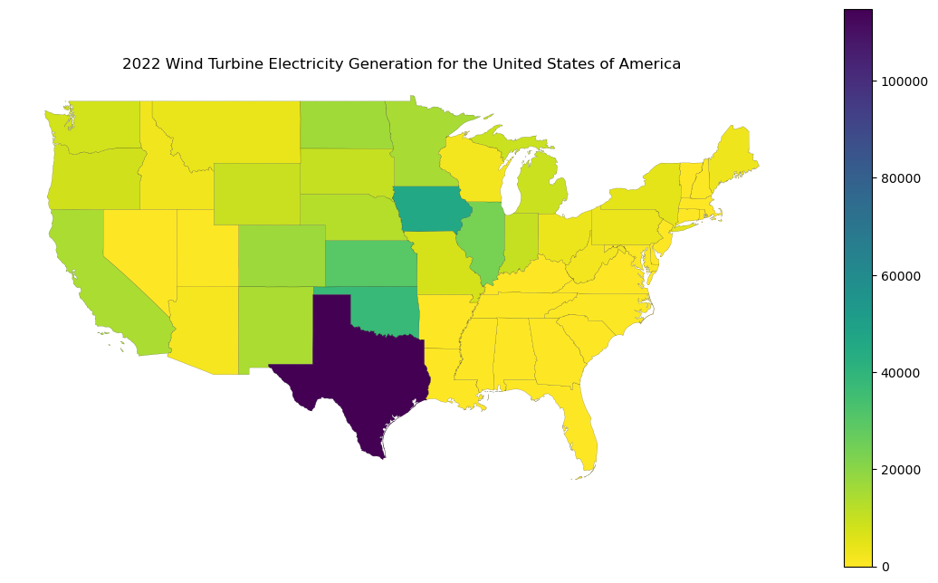
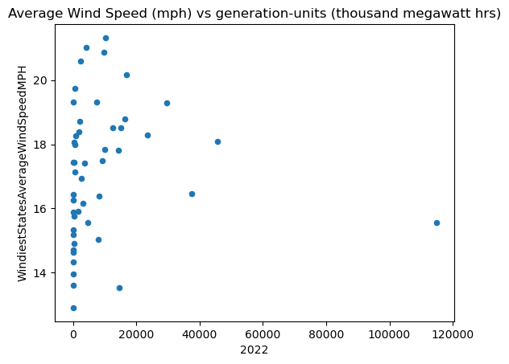
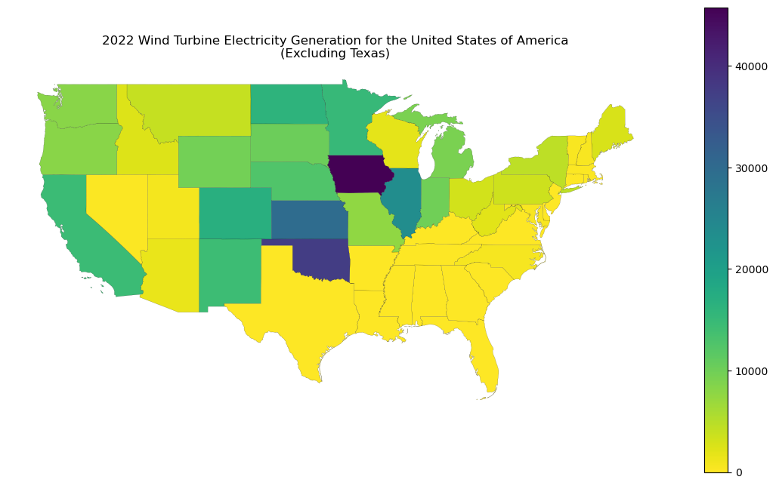
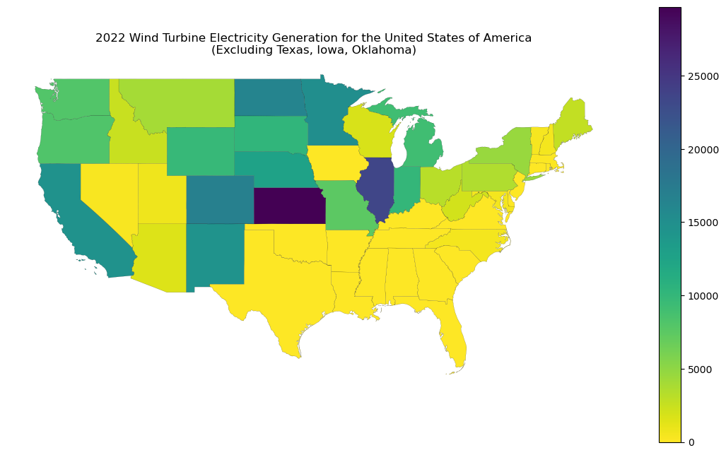
Correlation between Wind Speed & Turbine Location (State-level)
Outlier: Texas
Outliers: Oklahoma, Illinois
Correlation between wind power generation and average wind speed is 0.05!!!

Slide 11
Correlating
Wind Potential w/
Turbine Location

Slide 12
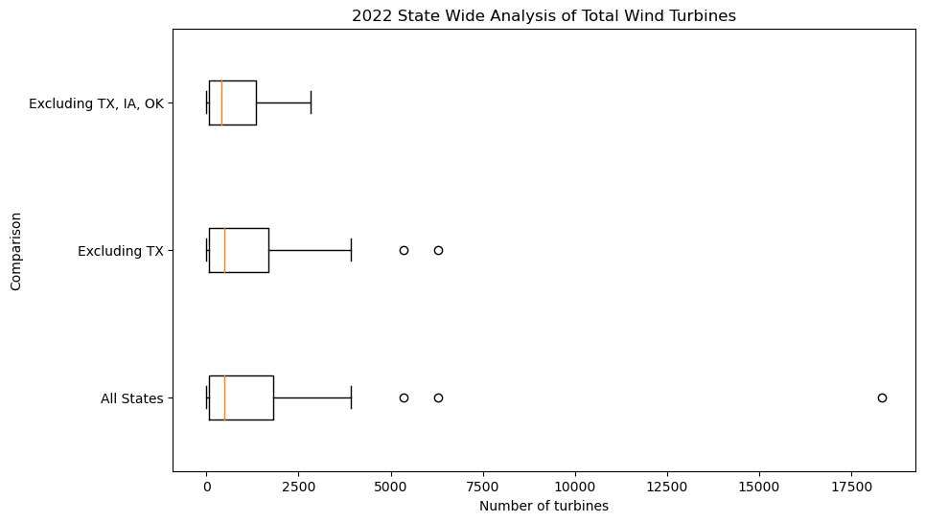
Wind Turbine Distribution

Slide 13
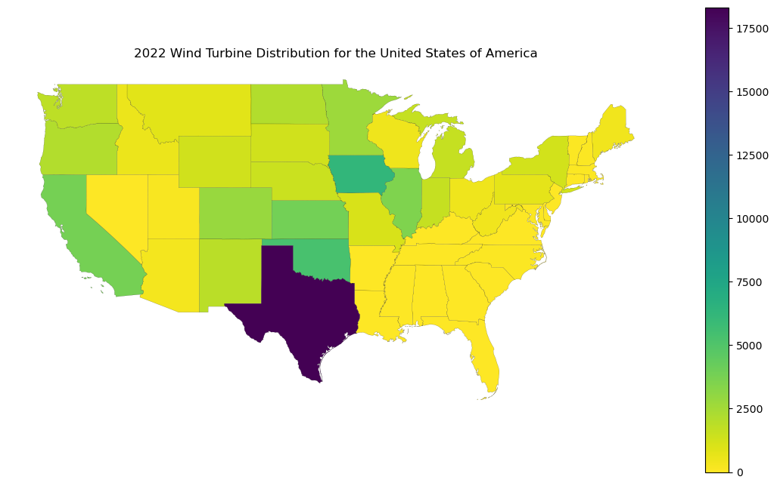
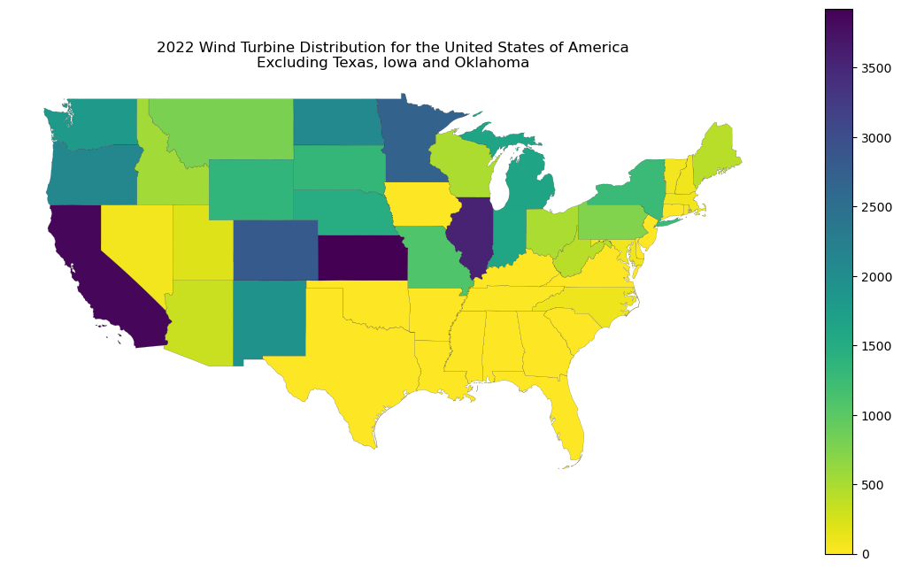
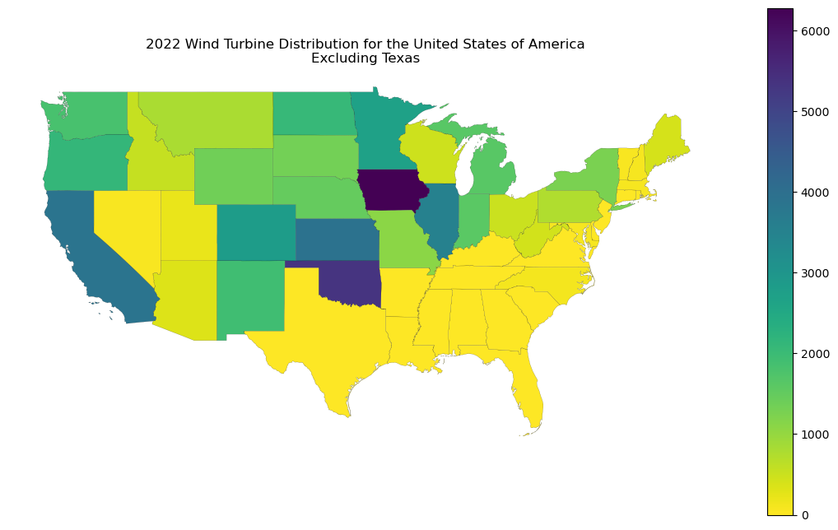
Wind Turbine Distribution
Outlier: Texas
Outliers: Oklahoma, Illinois

Slide 14
Results & Conclusions
Analysis of Legislation & Installations +
Supplier & Key Drivers of Energy Generation

Slide 15
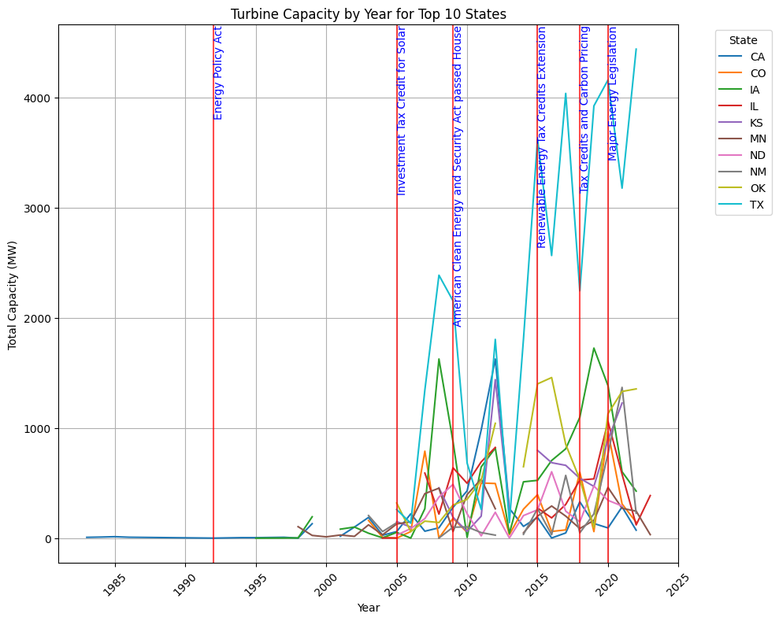
Turbine Capacity by Year, Top 10 States
The most substantial increases coincide with the Energy Policy Act and various tax credits, suggesting these policies have positively influenced turbine installations, and therefore, capacity.
1
2
6
Key Legislation
Energy Policy Act
Investment Tax Credit for Solar
American Clean Energy and Security Act
Renewable Energy Tax Credits Extension
Tax Credits & Carbon Pricing
Major Energy Legislation
4
5
3

Slide 16
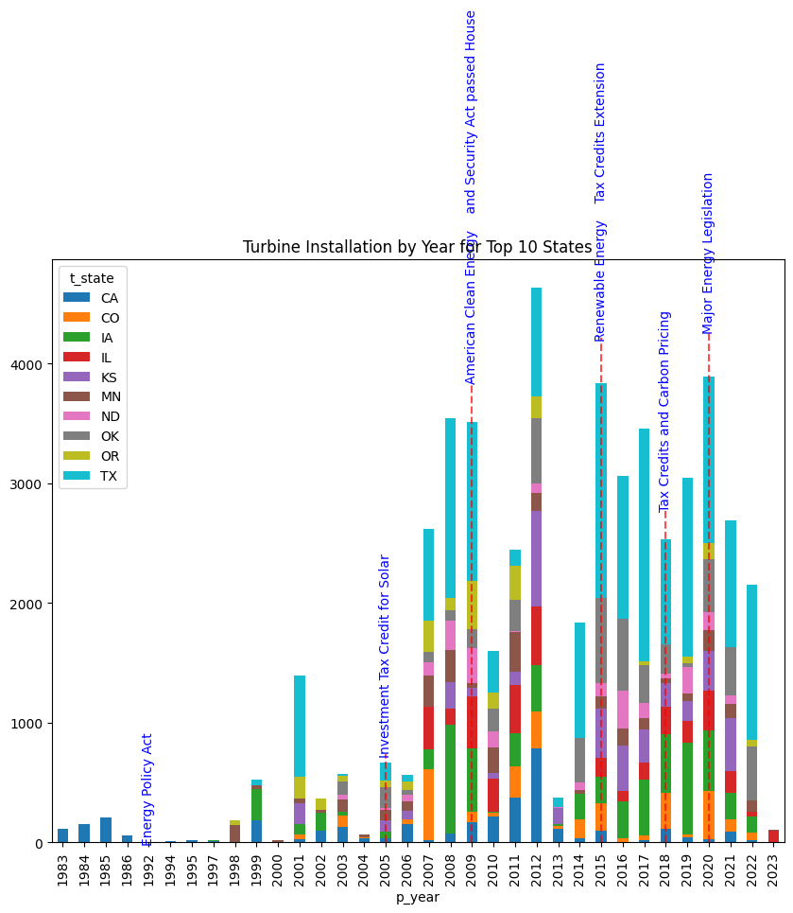
Turbine Installation Trends, Top 10 States
Texas consistently leads installations, which could be attributed to its favorable policies and possibly its geographic and wind profile.
Impact of policy is evident, with spikes in installations aligning with the introduction of tax credits and pricing incentives.
6
Key Legislation
Energy Policy Act
Investment Tax Credit for Solar
American Clean Energy and Security Act
Renewable Energy Tax Credits Extension
Tax Credits & Carbon Pricing
Major Energy Legislation
4
3
5
2
1

Slide 17
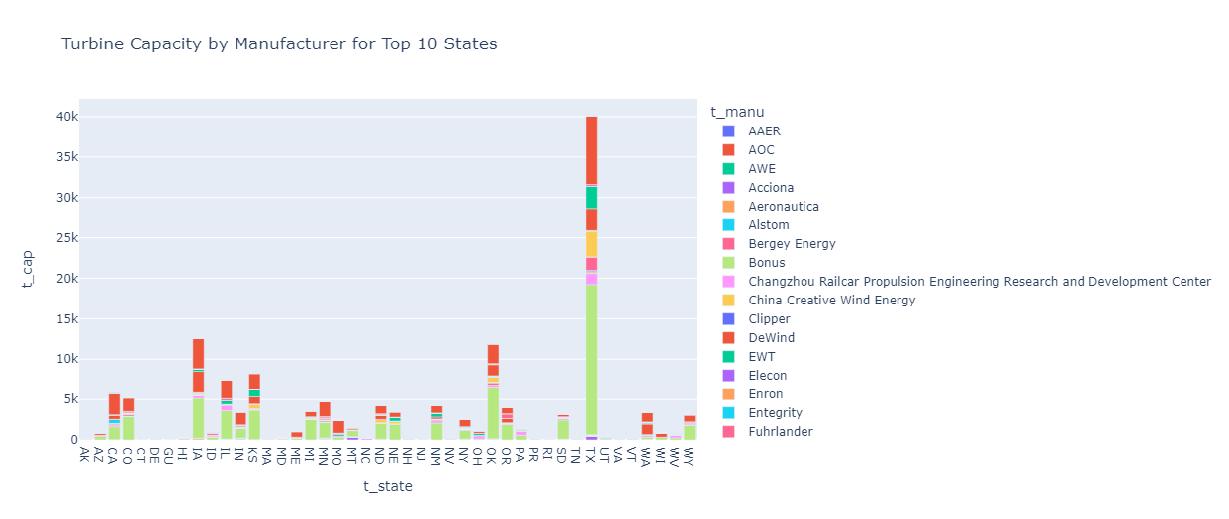
Turbine Capacity by Manufacturer for Top 10 States
Manufacturer
Conclusions
Distribution of turbine capacities varies significantly across manufacturers & states.
Certain manufacturers have a dominant presence in multiple states, indicating a strong market position.
The diversity of manufacturers within each state suggests a competitive market with multiple players.
Some states show a concentration of capacity from a single manufacturer, hinting at possible state-level agreements or preferences.
MWh
State

Slide 18
Future Development
The wind energy market is both diverse and competitive, with no single manufacturer monopolizing the capacity across the top 10 states.
Manufacturers with a broader presence across states may benefit from economies of scale, potentially offering them a competitive advantage.
Policy makers and new market entrants should consider the varying state preferences and existing market shares when planning for expansion or entry.
Policy measures, particularly tax incentives and renewable energy legislation, are critical drivers of turbine capacity expansion.
The fluctuations and drops in some states' capacity post-policy expiration indicate the importance of sustained policy support.
The data suggests a correlation between policy initiatives and investment in turbine capacity, with lead times for reaction to policy changes.
For continued growth, a combination of long-term policies and natural resource utilization is recommended.
Manufacturers
Policy
Long-Term Vision
Further analysis could explore the reasons behind the market share distribution, such as economic incentives, manufacturer reliability, or state renewable energy policies.

Slide 19
Thank you!
Team
Turbine
Questions, Comments, Ideas?
AI Boot Camp

Slide 20
Reference

Slide 21
Analyzing Trends in Turbine Capacity
Results & Conclusions
The line graph represents the growth of turbine capacity in megawatts (MW) for the top 10 states from the early 1980s to 2025.
There is a general upward trend in turbine capacity over time, with significant growth observed after policy initiatives, indicated by the vertical lines.
The most substantial increases coincide with the Energy Policy Act and various tax credits, suggesting these policies have positively influenced turbine installations.
States like Texas (TX) and Iowa (IA) show particularly strong growth, which may be influenced by their natural wind resources in addition to policy support.

Slide 22
Analysis of Turbine Installation Trends
Results & Conclusions
The plot illustrates the turbine installation trends by year across the top 10 states.
There is a noticeable increase in installations following specific policy implementations, such as tax credits and renewable energy legislation.
Texas (TX) consistently leads in the number of installations, which could be attributed to its favorable policies and possibly its geographic and wind profile.
The impact of policy is evident, with spikes in installations aligning with the introduction of tax credits and pricing incentives.

Slide 23
Analysis of Turbine Capacity by Manufacturer across Top 10 States
Results & Conclusions
The distribution of turbine capacities varies significantly across manufacturers and states.
Certain manufacturers, such as those represented by the red bars, have a dominant presence in multiple states, indicating a strong market position.
The diversity of manufacturers within each state suggests a competitive market with multiple players.
Some states show a concentration of capacity from a single manufacturer, hinting at possible state-level agreements or preferences.

Slide 24
Conclusions and Implications
Results & Conclusions
Policy incentives play a crucial role in the adoption of wind energy technologies, as indicated by the installation surges post-policy enactments.
The cyclical nature of installations suggests that temporary incentives may lead to a 'boom-bust' pattern, pointing to the need for stable long-term policies.
The variance among states highlights the importance of state-specific policies and incentives in driving renewable energy investments.
Future strategies should focus on sustaining growth through consistent policy support to avoid market volatility and to continue driving renewable energy adoption.

Slide 25
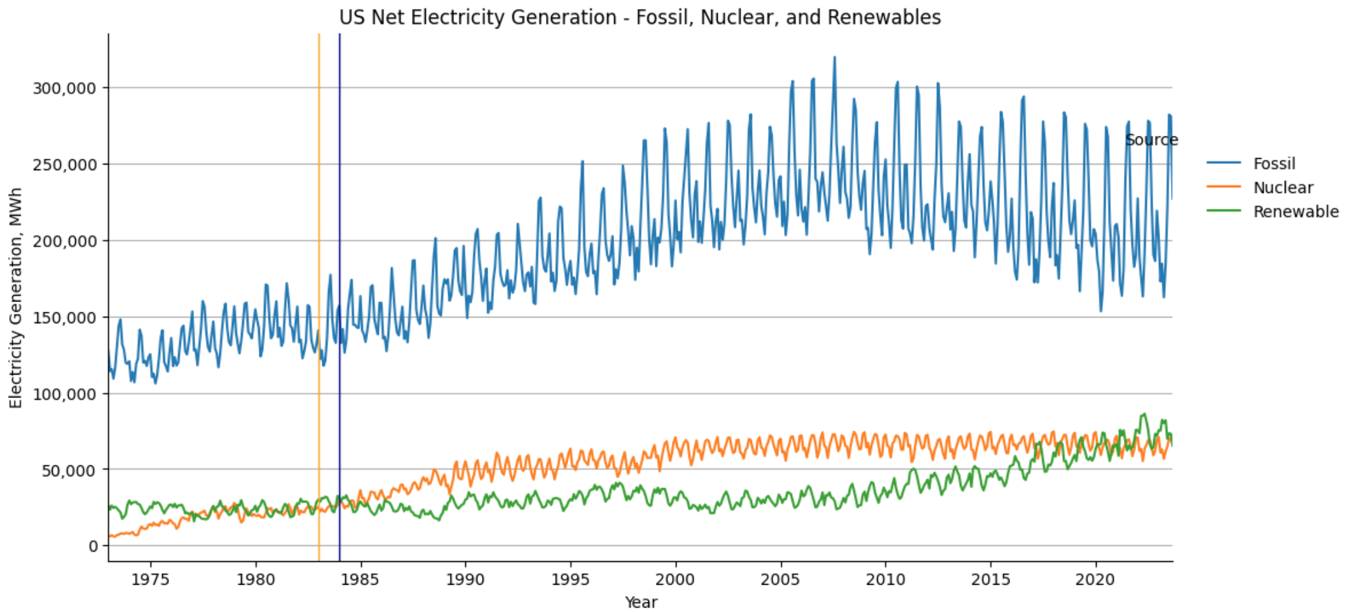
Results & Conclusions

